Slide 1
Today
Lecture 18: The Josephson effect --- beyond tunnel junctions (SNS, microbridges, SFS, …)
Discussion of the Josephson effect in five parts:
Theory and phenomena
RSJ model
Magnetic field effects
Fluctuations and quantum tunneling
Beyond tunnel junctions (SNS, microbridges, SFS, …)
Next time
Lecture 19: The dc SQUID --- models

Slide 2
Plan for the rest of the course

Slide 3
Final project
27 students
6 groups of 4-5
Explore a topic --- make a set of slides
12 minute presentation on May 12 (last day of class)
Topics:
Conventional superconducting qubits vs. topological superconducting qubits
Superconducting qubits vs. ion trap qubits
Superconducting qubits vs. semiconductor qubits
Quantum Supremacy
Superconductors for Quantum Networking
Superconductors for Quantum Sensing
Quantum computing for discovery of new superconductors
Or a topic of your choosing

Slide 4




Josephson Effects in Weak Links
tunneling derived for SIS tunnel junction ⇒ $I_{N}=G\left(V\right)V$
(qp)
$$\frac{πΔ}{2ⅇR}$$
(pair)
$I_{S}=$
Josephson effect is more universal ⇒ QM description in terms of phase-locking of superconductor islands
How to define Josephson effect?
Not supercurrent common in superconductors
Not $I=I_{c}\sin{φ}$
Key property: Periodic CPR $I=I\left(φ\right)$
(Waldram)
$ψ→0$ for some phase $φ$ (usually $φ\sim π$)
Key experiments: CPR measurements (not common/challenging)
AC-induced steps (steps)
SQUID behavior/diffraction pattern behavior
What is different ?
Critical current vs. T  how excitation suppress superconductivity
Critical current vs. B  current-phase relation

Slide 5
Types of Josephson junctions
S-I-S insulator
S-N-S normal metal
S-F-S ferromagnet
S-Sm-S semiconductor
S-TI-S topological insulator
S-v-S vacuum (STM)
S-g-S graphene
microbridge
“Dayem bridge” (variable thickness microbridge)

Slide 6
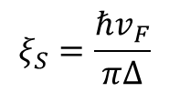
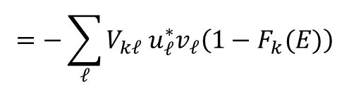
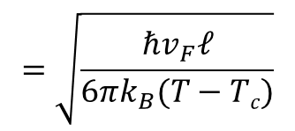


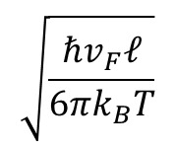



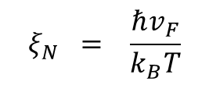
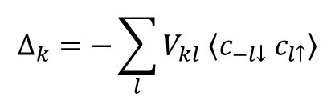
SNS
$$d$$
S
N
S
F(x)
PROXIMITY EFFECT
S
N
leakage of Cooper pairs out of S into N
leakage of quasiparticles out of N into S
⇒ non-local
I
$$ξ_{S}$$
I
$$ξ_{N}$$
x
Results in the spatial variation of parameters
$$Δ_{k}=−\sum_{l}{V_{kl} \left\langle c_{−l↓}{ c}_{l↑}\right\rangle }$$
$$=−\sum_{ℓ}{V_{kℓ} u_{ℓ}^{∗}v_{ℓ}\left(1−F_{k}(E)\right)}$$
$$ξ_{S}=\frac{ℏv_{F}}{πΔ}$$
$$ξ_{N} = \frac{ℏv_{F}}{k_{B}T}$$
clean
$$\sqrt{\frac{ℏv_{F}ℓ}{6πk_{B}T}}$$
$$Δ\left(\vec{r}\right) = g\left(\vec{r}\right) F\left(\vec{r}\right)$$
$$=$$
dirty
order
parameter
effective
pairing interaction
pair correlation function
– OR –
condensate amplitude
$$=\sqrt{\frac{ℏv_{F}ℓ}{6πk_{B}(T−Tc)}}$$
SC
Proximity effect ⇒ $F \left(\vec{r}\right)$ smears out across the interface

Slide 7






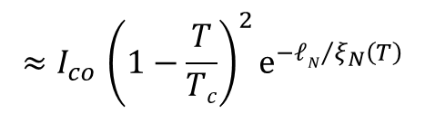




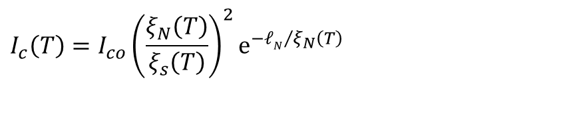


Temperature dependence
$$ξ_{N}(N)$$
$$ξ_{N}(S)$$
$$ξ_{S}$$
$$ξ$$
Critical current
$$T$$
$$I_{c}\left(T\right)=I_{co}{\left(\frac{ξ_{N}\left(T\right)}{ξ_{s}\left(T\right)}\right)}^{2}ⅇ^{−{ℓN}/{ξ_{N}}\left(T\right)}$$
0
$$T_{cN}$$
$$T_{cS}$$
Spatial dependence
$${≈I}_{co}{\left(1−\frac{T}{Tc}\right)}^{2}ⅇ^{−{ℓN}/{ξ_{N}}\left(T\right)}$$
$$ℓN$$
S
N
S
$$I$$
SIN
N
SIS
S
S
I
$$T$$
$$T_{c}$$

Slide 8
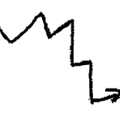
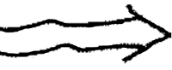
Microscopic picture
Normal conduction by diffusion through linear How is phase coherence mentioned?
S
S
N
picture
ANDREEV REFLECTION – process for charge transport across $N→S$interface
N
S
electrons above the gap can find states in the superconductor
electrons below have no available states
N
S
electron from N incident on the barrier
hole created in N “retroreflected” to conserve energy and momentum
Cooper pair created in S
h
2e
e
probability depends on Ε/Δ

Slide 9
SNS Josephson junction
S
N
S
Forward and back scattered electrons and holes are coherent
broad qp states in N
maintain phase coherence across the junction
e
2e
2e
h
“bound states carry supercurrent”

Slide 10
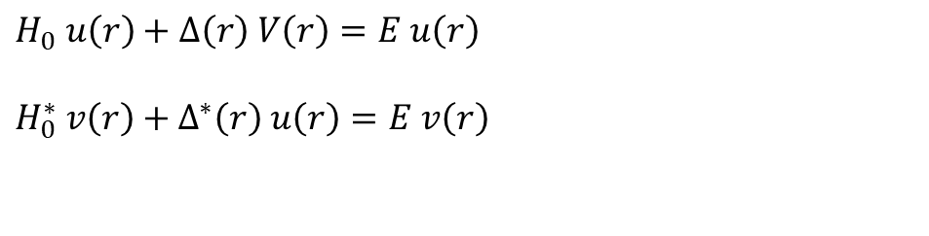




Andreev reflection – (1964)
developed to explain as a decrease in the thermal conductivity at low T
B
A
D
C
I
Predicts shape of tunneling characteristics as the barrier height changes
extended by
Blonder-Tinkham-Klapwijk (BTK)
Bound states reflection & phase coherence ⇒ interference
(standing waves)
Schroedinger equations for qp’s
Solve Bogoliubov-deGennes equations
For $Δ\left(r\right)=0$, decouple into:
$$H_{0} u\left(r\right)+Δ\left(r\right) V\left(r\right)=E u\left(r\right)$$
$$H_{0}^{∗} v\left(r\right)+Δ^{∗}\left(r\right) u\left(r\right)=E v\left(r\right)$$
$$u_{k},v_{k}→u\left(r\right),v\left(r\right)$$
$$H_{0}u\left(r\right)=Eu\left(r\right)$$
momentum
space
position
space
$$−H_{0}^{∗}v\left(r\right)=Ev\left(r\right)$$
$$Δ\left(r\right)=g\left(r\right)F\left(r\right)$$
define normal qp’s (excitations)

Slide 11
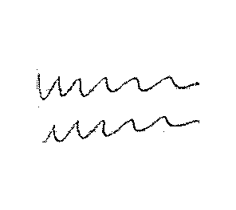
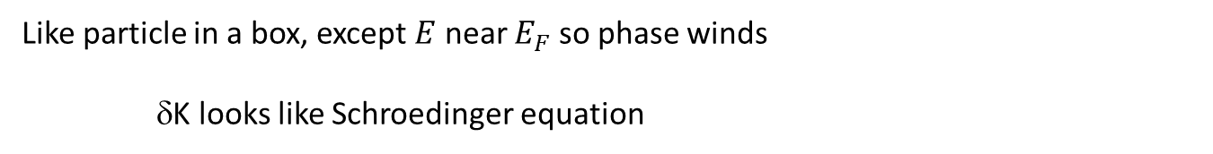
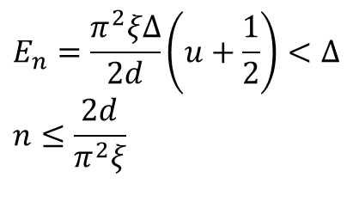
More oscillations --- the deGennes – St. James oscillations
N
S
$$E_{n}=\frac{π^{2}ξΔ}{2d}\left(u+\frac{1}{2}\right)<Δ$$
$$n≤\frac{2d}{π^{2}ξ}$$
Like particle in a box, except $E$ near $E_{F}$ so phase winds
δK looks like Schroedinger equation

Slide 12




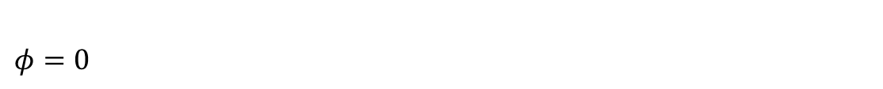
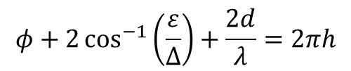






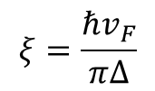



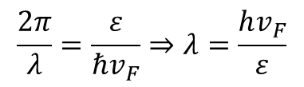

N
Ballistic SNS junction
S N S
e
$$ε$$
$$k_{F}+δk$$
h
$$k_{F}−δk$$
$$δ_{K}$$
$$δ_{K}$$
$$ε=ℏv_{F}δk$$
bound state energy
$$δk=$$
$$\frac{2π}{λ}=\frac{ε}{ℏv_{F}}⇒λ=\frac{hv_{F}}{ε}$$
phase diff. evanescent path
$$φ_{2}$$
$φ=0$
$$φ_{1}$$
$$\frac{π^{2}ξΔ}{4d}\left(n+\frac{1}{2}\right)$$
evanescent tail
$$ε_{n}= <Δ$$
$$\frac{4d}{π^{2}ξ}$$
$$φ+2\cos^{−1}\left(\frac{ε}{Δ}\right)+\frac{2d}{λ}=2πh$$
$$ξ=\frac{{ℏv}_{F}}{πΔ}$$
$$n<$$
currents cancel
$φ$ finite currents do not cancel ⇒ net supercurrent

Slide 13
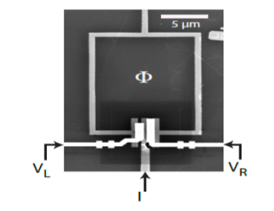
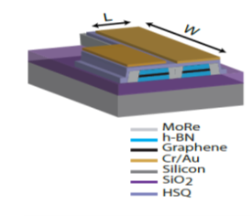
Superconductor-Graphene-Superconductor Junctions
High transparency states give higher harmonic contributions to the CPR, inducing skewness
Titov and Beenaker, PRB 94, 041401 (2006)
Interferometer technique (Urbana)
Asymmetric SQUID technique (Delft)
C. English et al., PRB 94, 115435 (2016)
Nanda et al., arXiv:1612.06895v2

Slide 14
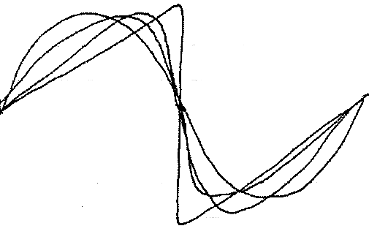



Microbridge solve GL equations
$$J_{c}^{GL}=\frac{c}{3\sqrt{6}π}\frac{H_{c}\left(T\right)}{λ\left(T\right)}{\sim \left[1−{\left(\frac{T}{Tc}\right)}^{2}\right]}^{3/2}$$
S
S
I
current & piling
Crossover from bulk SC behavior to Josephson behavior
Modification of CPR :
long
wide
short
narrow
$$I$$
$$φ$$
Superconducting weak links
K. K. Likharev
Rev. Mod. Phys. 51, 101 (1979)

Slide 15
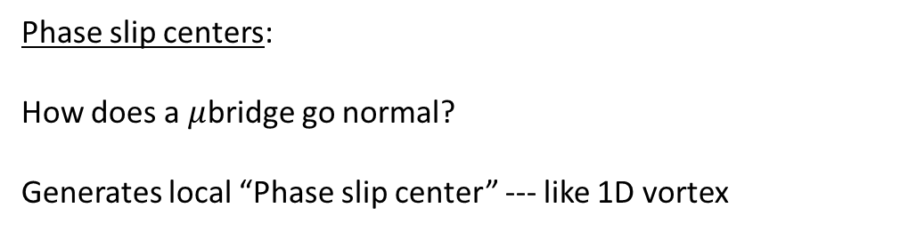
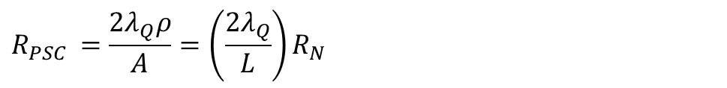



Phase slip centers:
How does a $μ$bridge go normal?
Generates local “Phase slip center” --- like 1D vortex
$$Q^{∗}$$
$$Δ$$
I
Charge imbalance --- excess of charge in the qp distribution
Non-equilibrium region nucleates when Ic exceeded
I
$$λQ^{∗}$$
$$R_{PSC }=\frac{2λ_{Q}ρ}{A}=\left(\frac{2λ_{Q}}{L}\right)R_{N}$$
V
discrete PSC’s – spread out evenly in principle but pinned by defects in real samples
4
3
2
Quantum phase slips? --- still debated whether PSC can be generated by macroscopic quantum tunneling
(Alexey Bezryadin has studied this)
1
0
I

Slide 16
Point contact Josephson junctions
SIS?
SNS?
microbridge?
Common technique: “break junctions” --- break a wire and them re-contact
Useful to make clean contacts in exotoc materials, e.g. HTSC

Slide 17
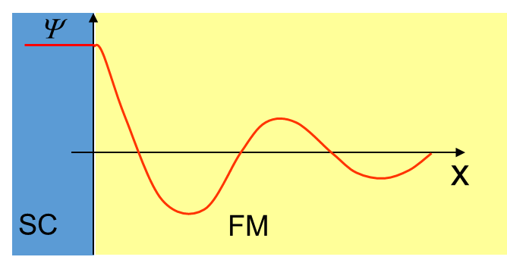
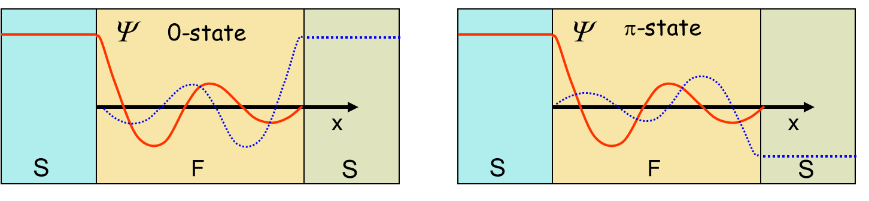
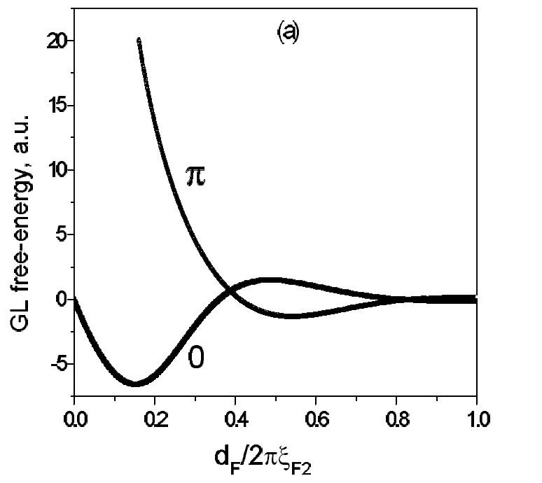
Superconductor-Ferromagnet-Superconductor Junctions
SC order parameter decays AND oscillates due to magnetism --- FFLO state
λ ~ nd
λ ~ (n+½) d
0
π
π
Order parameter oscillations
0
Proximity decay
Can move across the 0-π transition by changing the barrier thickness or the temperature

Slide 18
π-Josephson junction
0-junction
minimum energy at 0
π-junction
minimum energy at π
I
I
I = I_{c}sin(π+φ) = -I_{c} sinφ
φ
φ
π
negative critical current
E
E
E = E_{J} [1 - cos(π+φ)]
= E_{J} [1 + cosφ]
φ
φ
-2π
0
2π
-π
π
Spontaneously-broken symmetry
Spontaneous circulating current for β_{L}>1 in zero applied magnetic flux

Slide 19
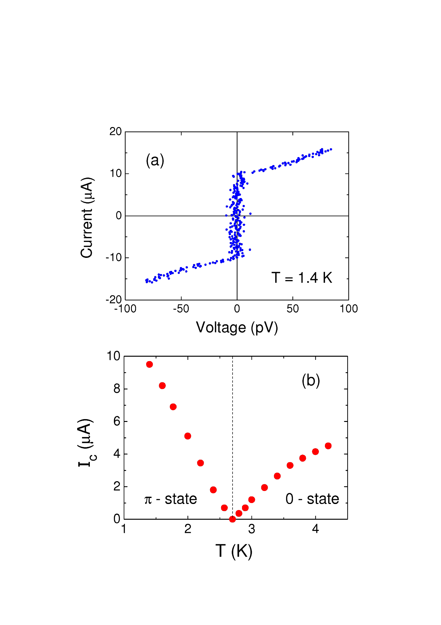
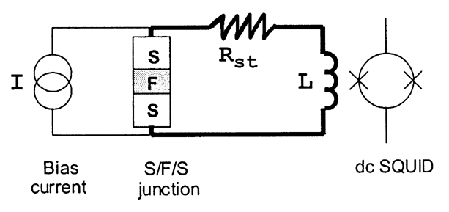
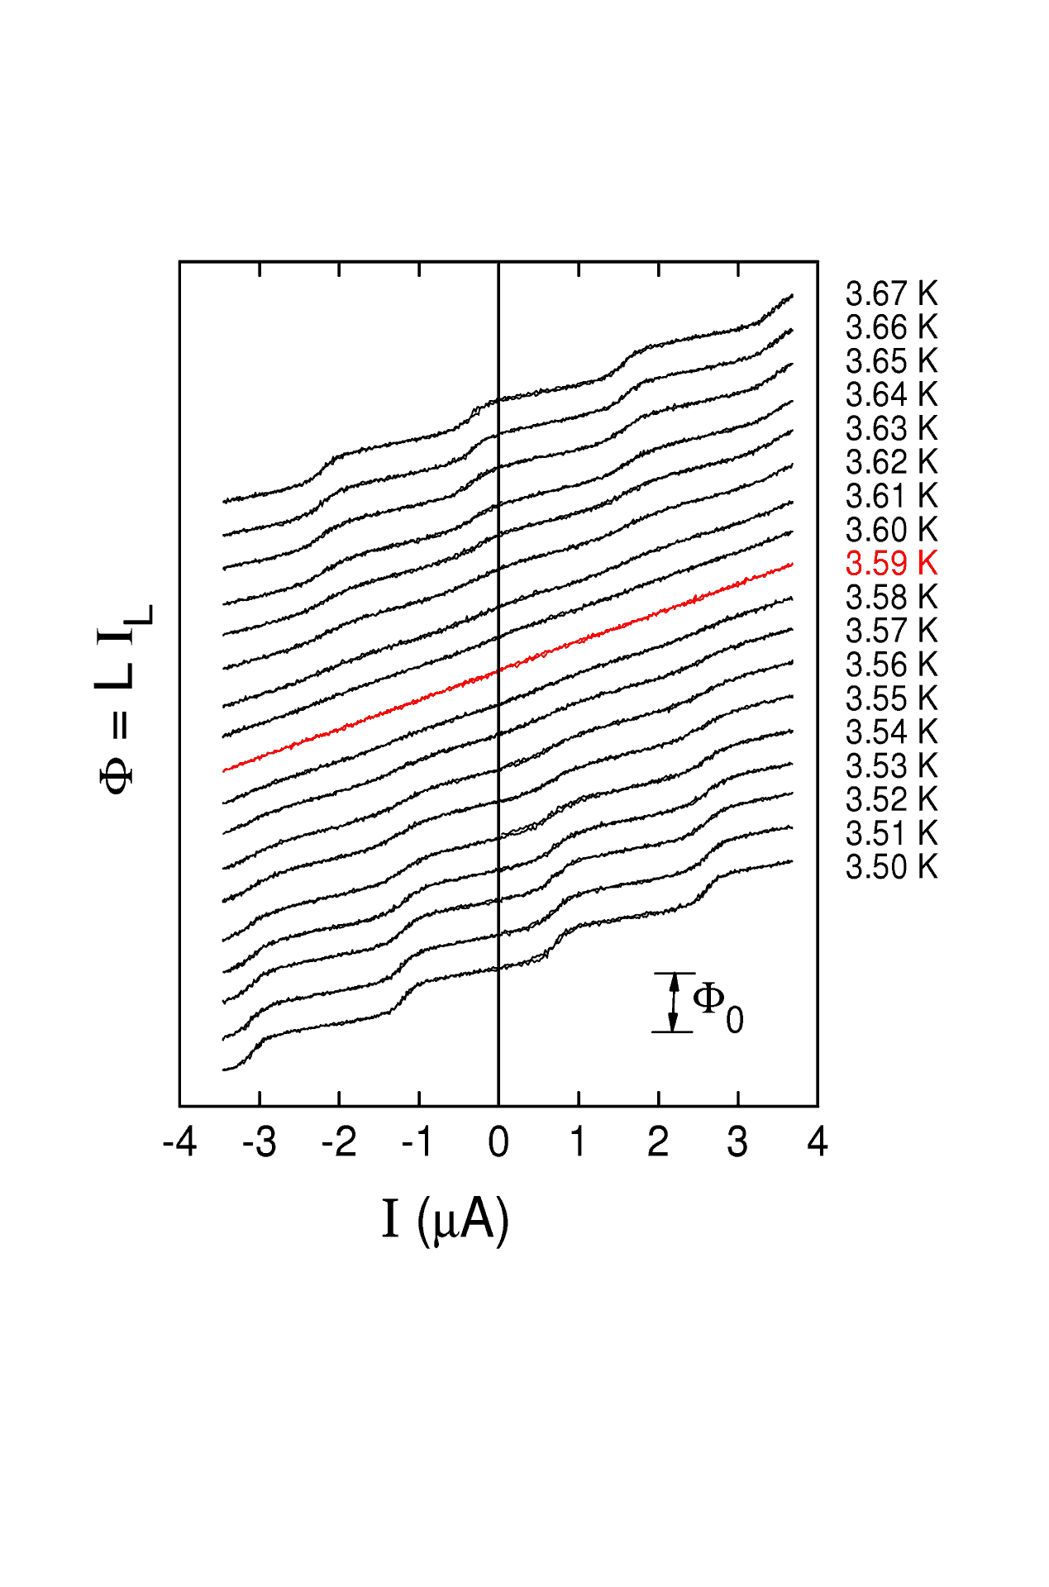
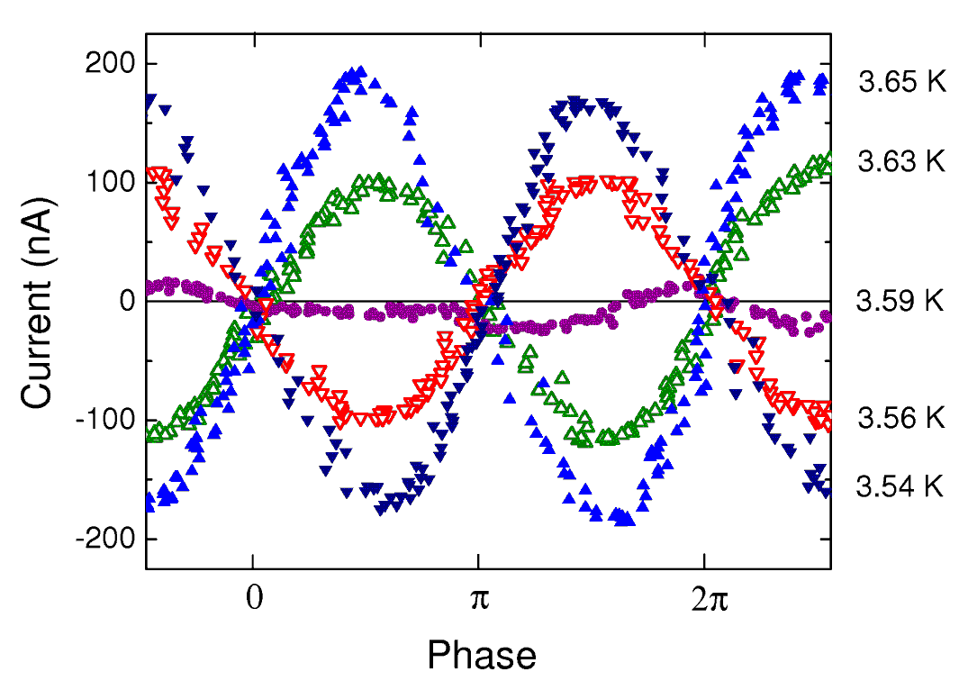
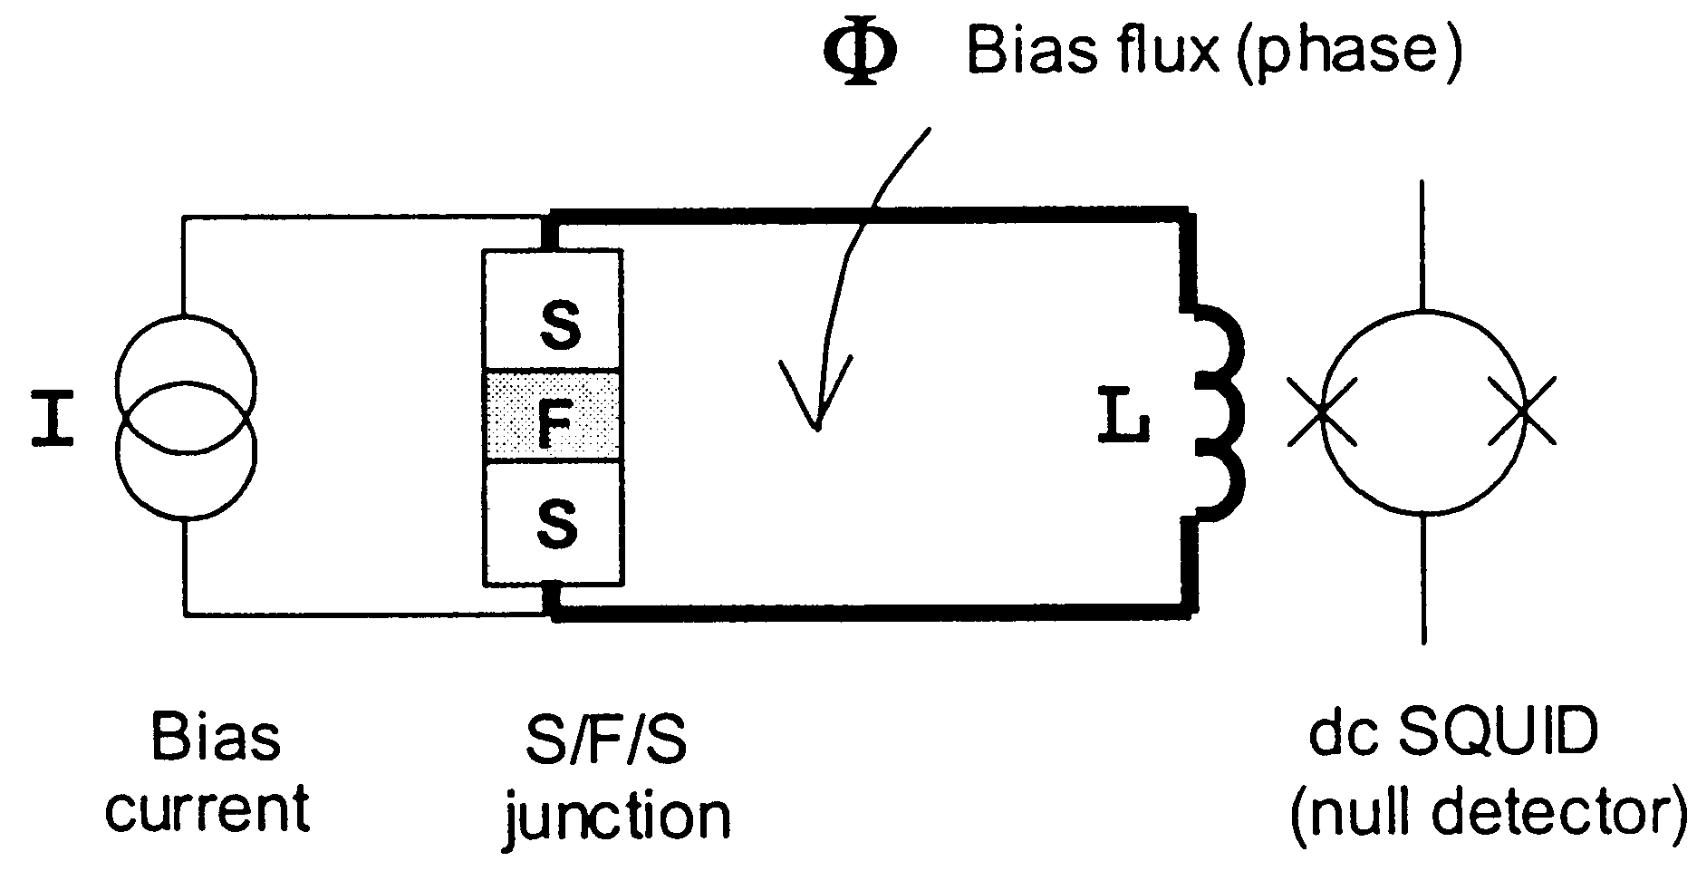
SFS Junctions --- mapping the 0-junction to π-junction transition
Current-Voltage measurement
V. Ryazanov et al. (Chernogolovka)
Current-Phase Relation measurement
M
Φ
S. Frolov et al. (Urbana)

Slide 20
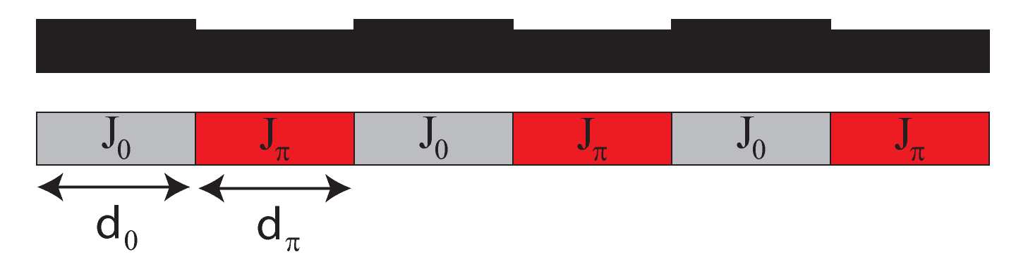
SFS Junctions --- looking for higher harmonics
The vanishing of the first-order Josephson effect allows a search for higher harmonics in the CPR
T = 2.58K
I_{c2}
T = 2.40K
T = 2.27K
T = 2.20K
I_{c1}
I_{c2} ≈ +35μA
T = 1.97K
T_{π}
T = 1.81K
Origin: rapid spatial changes in the critical
current from 0-junction to π-junction
M. Stoutimore et al. (Urbana)

Slide 21
Josephson Interferometry: what it tells you
Critical current variation
Magnetic field variations
Gap anisotropy
Domains
Charge traps
Current-phase relation
Order parameter symmetry
Flux focusing
Trapped vortices
Magnetic particles
Non-sinusoidal terms
π-junctions
Exotic excitations e.g. Majorana fermions
Unconventional superconductivity

Slide 22
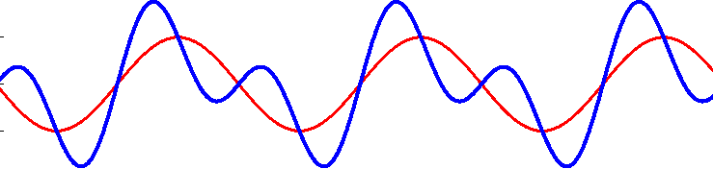
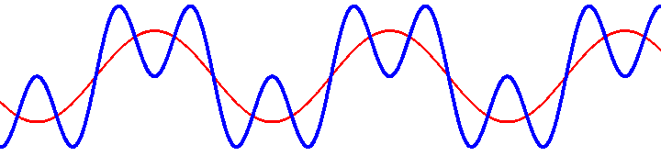
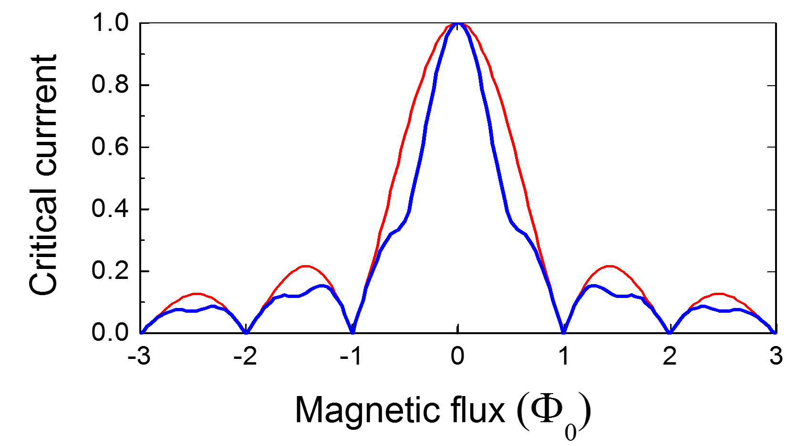
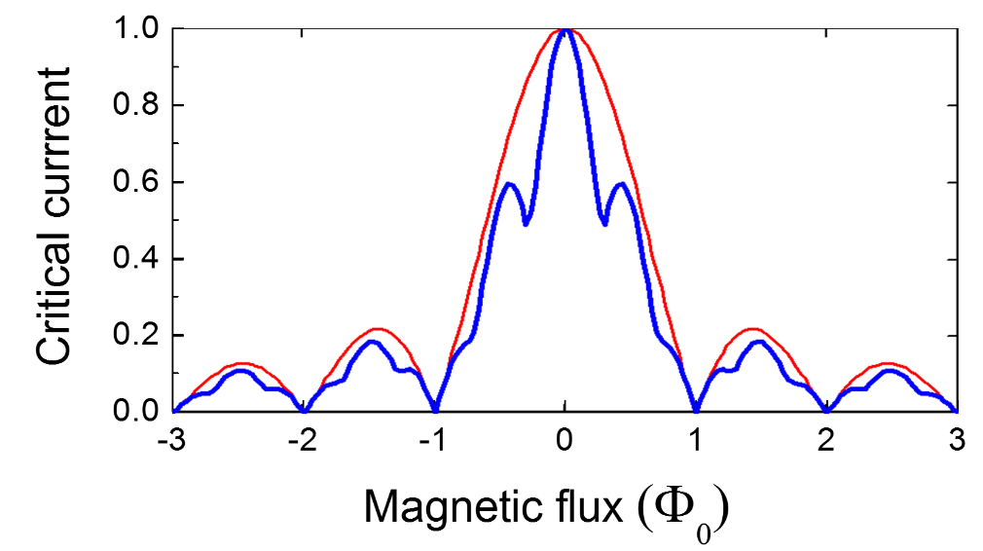
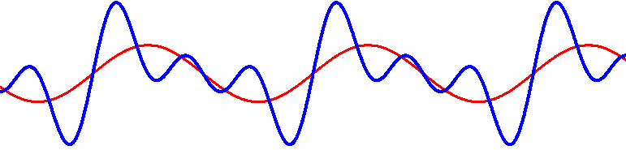

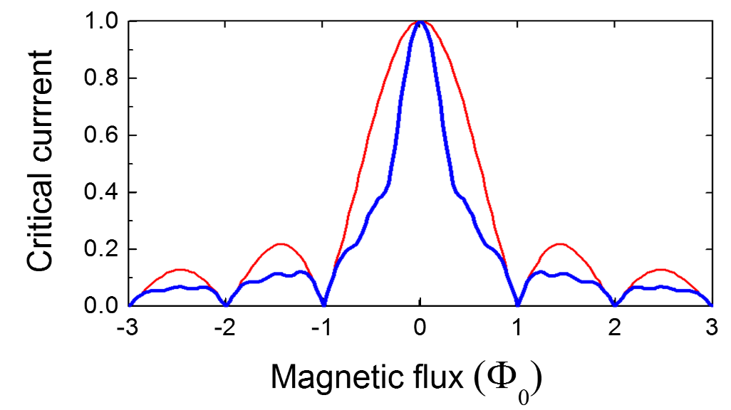
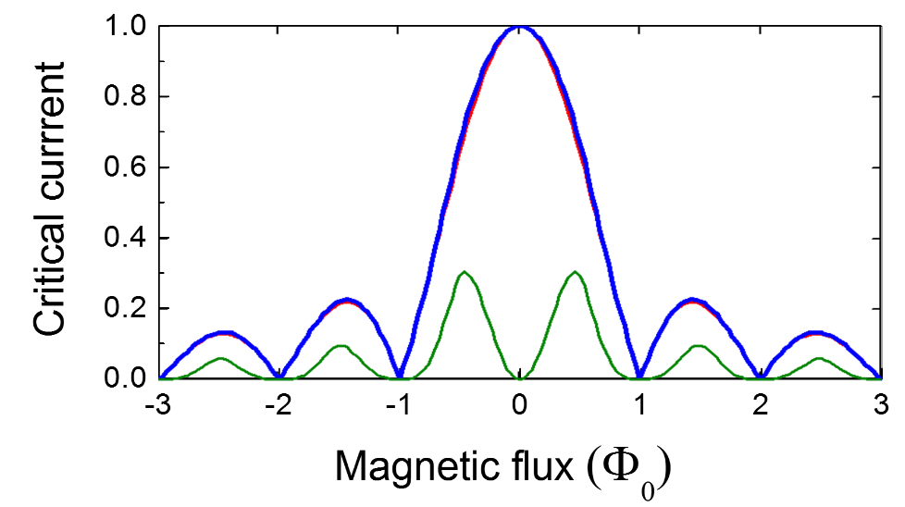
Effect of non-sinusoidal CPR on diffraction patterns
sin(φ) + sin(2φ)
sin(φ) + sin(3φ)
sin(φ) + sin(2φ) + sin(3φ)
Skewed CPR
x10

Slide 23
SFS: Josephson interferometry measurements
Nb-CuNi-Nb junctions
Experiment
Simulation
Simulation:
Observe signatures of the non-sinusoidal CPR in the Josephson interferometry measurements

Slide 24
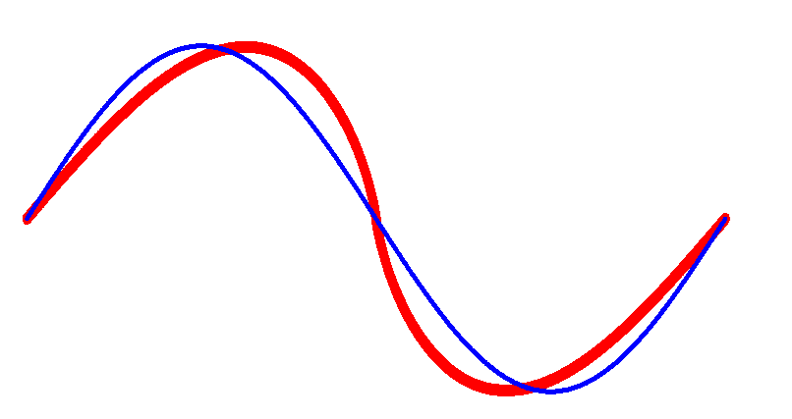
Direct measurement of the Current-Phase Relation
Screening technique (Jackel)
Interferometer technique (Waldram)
I_{c}
I_{c}
Junction embedded in SC loop (rf-SQUID)
Inject flux  induces circulating current
Detect flux with SQUID
Junction in SC loop (rf-SQUID)
Inject current  divides according to phase
Detect flux with SQUID
Extract CPR
First used to study the properties of superconducting microbridges  skewed CPR arising from an online inductance that gives extra phase

Slide 25
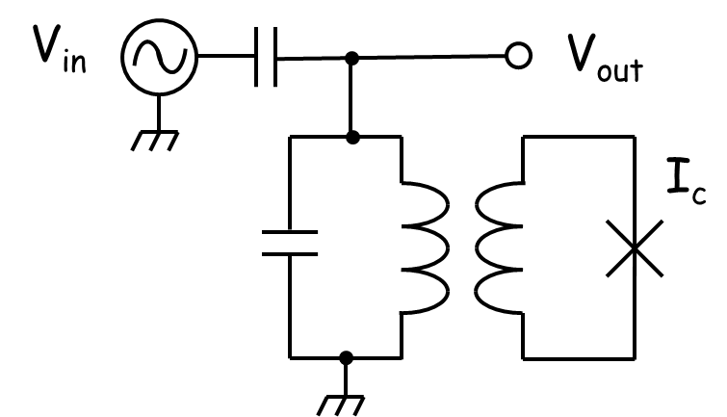
Direct measurement of the Current-Phase Relation
Dispersive technique (Silver, Deaver, Il’ichev)
Asymmetric dc SQUID technique
I_{c1}
I_{c2}
I_{c1} << I_{c2}
Junction embedded in SC loop (rf-SQUID)
inductively-coupled to a tank circuit
Excite with rf signal  induces rf currents
Readout phase shift between V_{in} and V_{out}
Extract CPR
Junction embedded in dc SQUID
Apply flux  induces circulating current
Measure critical current vs. flux
Modulation is dominated by the phase evolution of the small junction

